Slide 1
PnP Community Call – September 2015
aka.ms/OfficeDevPnP
aka.ms/OfficeDevPnPYammer
aka.ms/OfficeDevPnPGuidance
aka.ms/OfficeDevPnPVideos
PnP Core Team

Slide 2

Agenda
Demos, demos, demos
Monthly highlights
Contributions and other topics
Roadmap and next steps

Slide 3

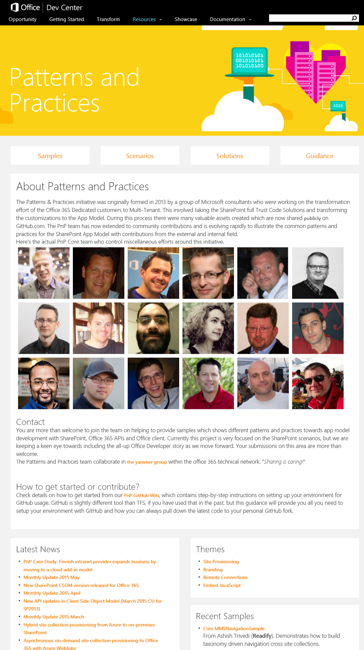
Developer
Patterns & Practices
aka.ms/OfficeDevPnP
aka.ms/OfficeDevPnPYammer
aka.ms/OfficeDevPnPMSDN
aka.ms/OfficeDevPnPVideos
aka.ms/OfficeDevPnPTraining

Slide 4
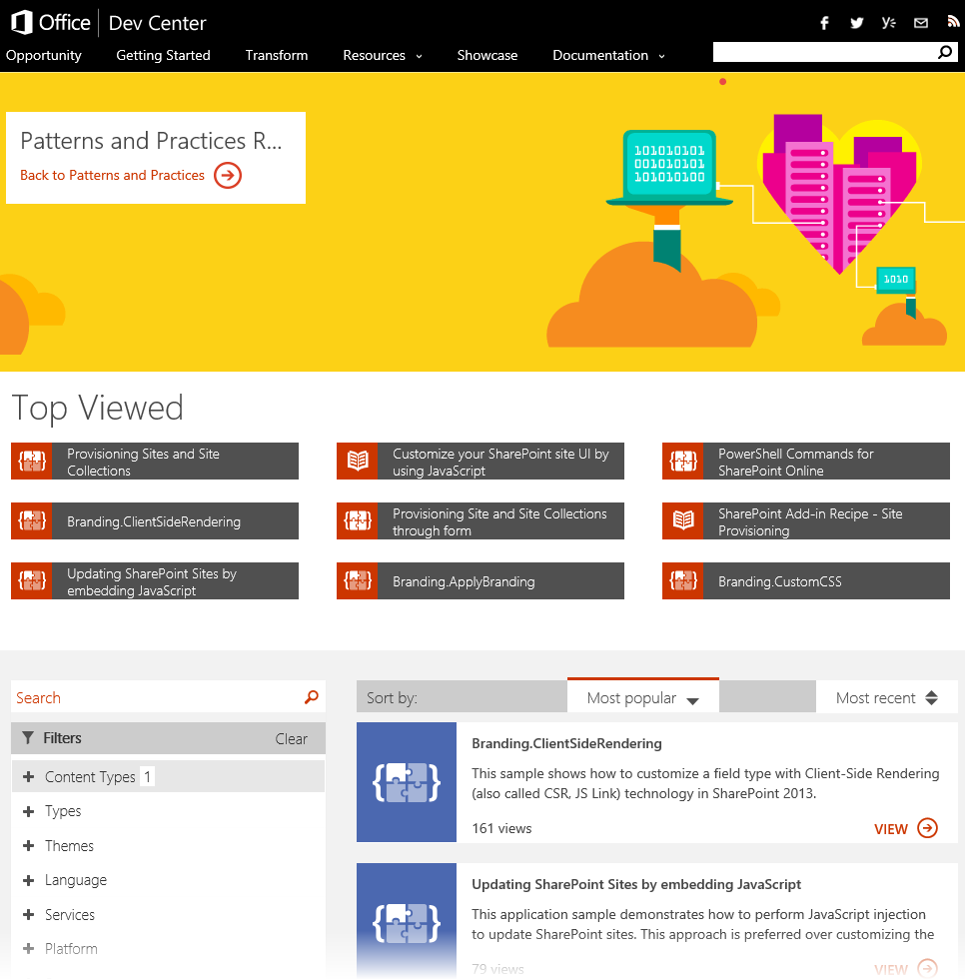
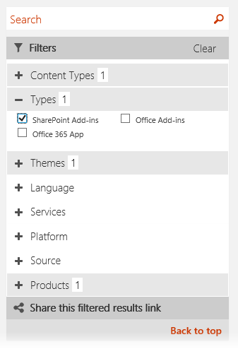
How to find PnP samples or guidance? dev.office.com > Resources > PnP > Sample / Guidance

Slide 5
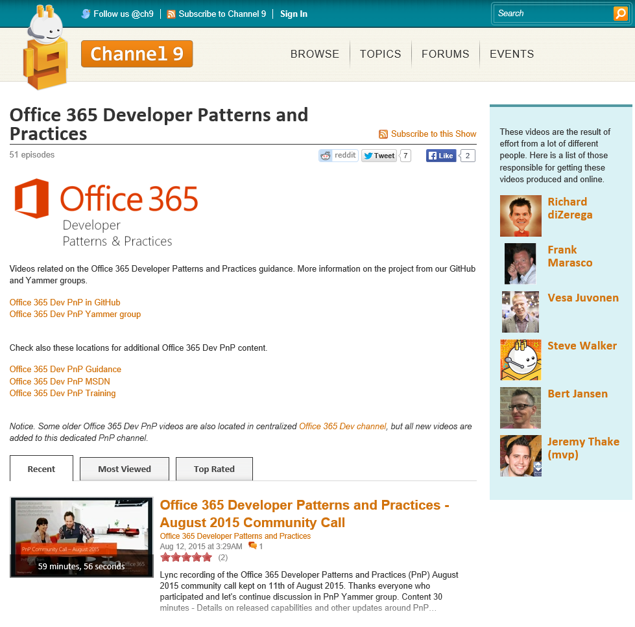
How to find PnP videos? aka.ms/OfficeDevPnPVideos
Demo videos
Training videos
Community call recordings

Slide 6
Statistics– Key numbers (previous month)
Forked 928 times (836, 640, 528, 444, 360, 282, 227, 190, 135)
907 merged/closed pull requests (800, 679, 593, 479, 384, 329, 280, 236, 189)
182 closed issues (169, 145, 131, 122, 101, 73, 67, 58, 43)
More than 4050 unique visitors during last 2 weeks (3800, 4532, 4100, 4100, 3776, 2566, 3050, 2160)
Nuget package 8939 downloads (7977, 6698, 6004, 5440, 4711, 4450, 4030, 3800)
Yammer group has 3249 members (3098, 2648, 2437, 2251, 2013, 1739, 1525, 1419, 757)
aka.ms/OfficeDevPnPYammer
Facebook page has 249 likes (235, 199, 194, 175, 135, 121)
https://www.facebook.com/OfficeDevPnP

Slide 7
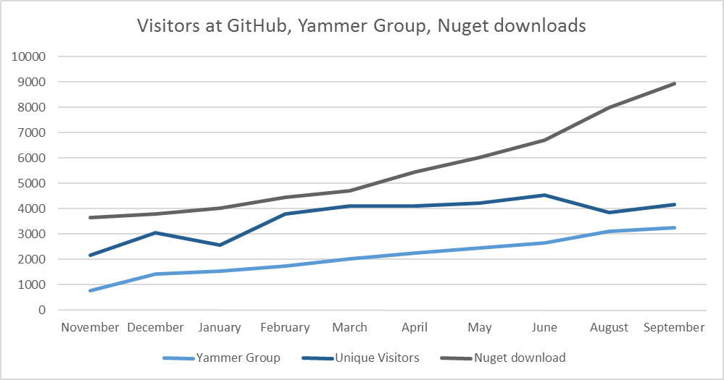
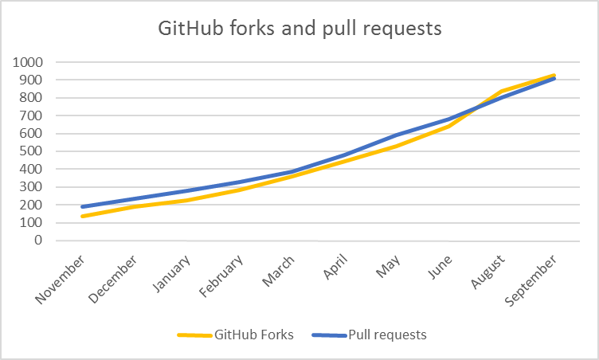

Slide 8
PnP GitHub Repository Split plan Completed – some samples to be still re-located
PnP – Main
PnP-Guidance – Articles and presentations
PnP-Provisioning-Schema
PnP-Sites-Core – New
PnP-PowerShell – New
PnP-OfficeAddIns – New
PnP-Office365-API – New
PnP-Partner-Pack – New
PnP-Transformation - New
PnP-ALM - Future
What does it mean?
Please move using the Dev branches of the new repositories when submitting pull requests
As an example – any update on the Core component should be now submitted towards the Dev branch under PnP-Sites-Core repository

Slide 9
Solution design considerations
From SP2010 MCM around 2010
What about future and models to support better cloud deployments?
Full trust solutions are not supported in cloud
Sandbox solutions are limited
What about automating deployments using “remote creation” models
Requires extensive remote API support which SP2010 doesn’t have, but…
Would be valid approach for on-prem and cloud – standardize all sides of deployments
Place for community project?
Notes:
Just a reference slides back from 2010 – we have come a long way from this since we started.

Slide 10
September Release - new samples
New sample Core.KnockoutJSForm shows how to implement a simple dynamic form using Knockout.js. In the sample standard Event display form is extended to enable registrations.
New sample Core.ListViewThreshold shows a ContentIterator implementation that can be used to query large lists as it reads items in batches.
New sample Core.RestFileUpload demonstrate how to upload files to SharePoint using REST APIs.
New sample Outlook.RelatedData demonstrates mail add-in for Outlook which extracts data from a mail message and retrieves data from Office 365 APIs.
New sample Provisioning.MicroSurvey shows a "microsurvey" web part, which will display a single question and gather up the answers. The app provisions SharePoint lists to hold the questions and answers, including custom New, Display, and Edit forms for one of the lists.
Multiple updated samples based on community contributions around bugs and improvements.

Slide 11
September Release – Core and engine updates
Core
Provisioning engine updates
PnPMonitoredScope model introduced for better logging with default implementation (more later)
Introduction of new token options for dynamic association
Nested token parsing support for tokens
Build and test automation improvements
Both PnP Core Nuget packages (cloud and on-premises) have been also updated accordingly.
PnP Provisioning Engine
Improved and updated delta handling
Overall quality and performance improvements
PnPMonitoredScope implementation for engine operations
Significant improvements on the on-premises support
PowerShell
Unit test model introduced for CmdLets
Updated documentation
Updated contribution guidance
Add configuration for Chocolately gallery
New Set-SPOUserProfileProperty cmdlet
New Set-SPOTraceLog cmdlet
Note. Some additional engine support capabilities were delayed for October release (2nd of Oct) to ensure sufficient testing for them. This includes support for workflows, regional settings, languages, auditing settings, publishing settings, etc.

Slide 12

Thank you for your assistance!
Anil-Lakhagoudar (GitHub alias) - lafe
Erwin van Hunen (Knowit AB) - @erwinvanhunen
Bob German (BlueMetal) - Bob1German
Ivan Vagunin (Knowit AB) - @ivagunin
jesotto (GitHub alias) - @jensotto
Matej Vodopivc (Agile9.net) - @matejvodopivc
lage (GitHub alias) - lafe
Mikael Svenson - @mikaelsvenson
Nige Price - @Nigel_Price
Omar Stewey - @omarstewey
Paolo Pialorsi (PiaSys.com) - @PaoloPia
Pascal Berger (IOZ AG) - pascalberger
Radi Atanassov (OneBit Software) - @RadiAtanassov
Reto Stadelmann (IOZ AG) - retostadelmann
Rodrigo Romano (Globant) - http://rodrigoromano.net
Sergei Sergeev - s-KaiNet
Tri Nguyen (QSsolutions) - mtringuyen
Vincent Verbeek @vverbeek87
Wictor Wilen - @wictor

Slide 13
Thank you for your assistance! – MS team
Antons Mislevics (Microsoft)
Bert Jansen (Microsoft) - @O365Bert
Brian Michely (Microsoft) - @brianmichely
Dan Budimir (Microsoft)
Frank Marasco (Microsoft) - @frank_marasco
Jeremy Thake (Microsoft) - @jthake
Kiki Shuxteau (Microsoft)
Patrick Rodgers (Microsoft)
Ron Tielke (Microsoft)
Sami Nieminen (Microsoft)
Steve Walker (Microsoft) - @sharepointing
Vesa Juvonen (Microsoft) - @vesajuvonen

Slide 14

Roadmap – October release plan
Provisioning engine
Add new capabilities like language settings, regional settings, auditing etc.
Documentation – also MSDN
Save site as a template – PnP-Partner-Pack
Core component v1.x
Continue evolving the Core component
Samples and solutions
Contributions from the field
Transformation IP
PnP Partner Pack
Articles and guidance
Additional MSDN updates
On-premises App model setup
ALM guidance for add-in/app model

Slide 15
ALM guidance – what would you like to see?
App lifecycle process in general
How to move apps cross dev-test-production environments
Differences between SP hosted and Provider hosted
Test environment for add-in testing
When to use isolated tenant vs. isolated site collections
Testing time deployment
Testing process for add-ins
Unit testing, Automated testing, load testing
Telemetry
Using application insights for telemetry
Environmental differences
Add-in development for Office 365
Add-in ALM in on-premises
General notes
Collect actuals scripts, code and processes as reusable assets for the field under PnP-ALM repo
Will start thread at Yammer for this…

Slide 16

Demos, demos, demos!
Matej Vodopivc – Mail Add-In For Outlook Using Office 365 APIs ~15 min
Bob German – Demonstration of "microsurvey" web part as add-in implementation ~15 min

Slide 17
Transform your code Providing add-in model patterns for SharePoint, Office and Office 365 APIs. Ready to use samples to get started.
130+ Visual Studio projects Common scenarios
Branding
Site provisioning
Remote event receivers
Large file support
Taxonomy driven navigation
And much more…
Contribute
This is open source project and open for contributions
Developer
Patterns & Practices
aka.ms/OfficeDevPnP

Slide 18

Questions?

Slide 19


© 2015 Microsoft Corporation. All rights reserved. Microsoft, Windows, and other product names are or may be registered trademarks and/or trademarks in the U.S. and/or other countries.
The information herein is for informational purposes only and represents the current view of Microsoft Corporation as of the date of this presentation. Because Microsoft must respond to changing market conditions, it should not be interpreted to be a commitment on the part of Microsoft, and Microsoft cannot guarantee the accuracy of any information provided after the date of this presentation. MICROSOFT MAKES NO WARRANTIES, EXPRESS, IMPLIED OR STATUTORY, AS TO THE INFORMATION IN THIS PRESENTATION.

